Slide 1
Python info session

Slide 2
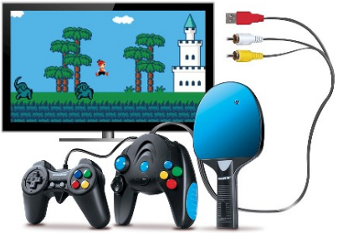
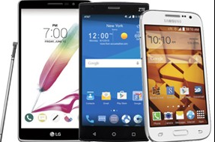
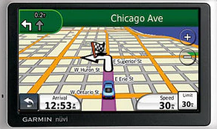
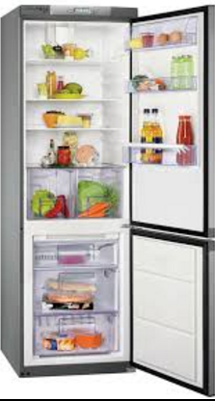
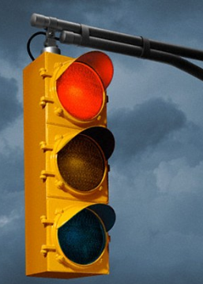
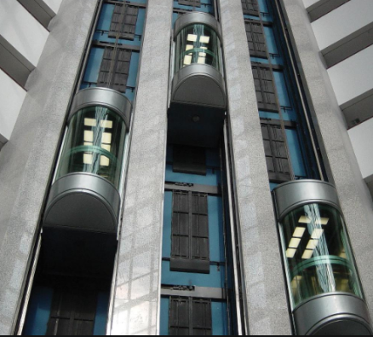
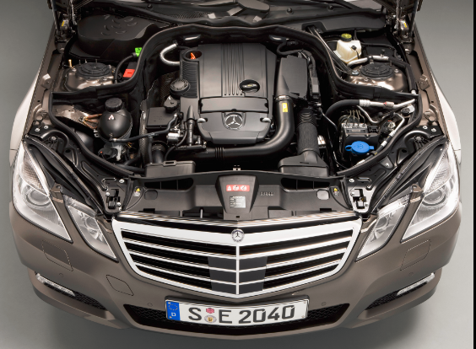
Does anybody know which items run on software?

Slide 3
Why do these items need software?
Software tells machine what to do.
We need to communicate with machine.

Slide 4

How does the machine work? What language does machine use?
Machine language: binary
00000000: Stop Program 00000001: Turn bulb fully on 00000010: Turn bulb fully off 00000100: Dim bulb by 10% 00001000: Brighten bulb by 10% 00010000: If bulb is fully on, skip over next instruction 00100000: If bulb is fully off, skip over next instruction 01000000: Go to start of program (address 0)
Machine is using binary, but human being CANNOT talk to the 1/0 all day.

Slide 5
How to communicate the machine in an easy way?
Programming language
Programs are a bit like thoughts

Slide 6
How many programming language are there in the world?
More than 500+

Slide 7
Programming language Examples
JavaScript
function myFunc(a, b) { return a * b; } document.getElementById('demo').innerHTML = myFunc(4, 3);
Python
words = ['cat', 'window', 'defenestrate'] for w in words: print w, len(w)

Slide 8
Programming language Examples
SQL
SELECT Country FROM Customers WHERE Country <> 'USA'
HTML
<!DOCTYPE html> <html> <head> <style> struct Ber body {background-color: yellow;}; </style> </head> <body>

Slide 9
Programming language Examples
Ruby
cities = %w[London Oslo Paris Amsterdam Berlin] visited = %w[Berlin Oslo] puts "I still need to visit:", cities - visited
C
typedef struct Bert Bert; typedef struct Wilma Wilma; struct Bert { Wilma *wilma; }; struct Wilma { Bert *bert; };

Slide 10
Programming language Examples
C++
#include using namespace std; int main () { cout << "Hello World!"; return 0; }
C#
class Foo { public int Value; public static explicit operator Foo(int value) { return new Foo(value); } }

Slide 11
Programming language Examples
Java
class HelloWorldApp { public static void main(String[] args) { System.out.println("Hello World!"); } }
PHP
<?php function add($x, $y) { $total = $x + $y; return $total; } echo "1 + 16 = " . add(1, 16);

Slide 12
Programming language Examples
Objective-C
- (int)method:(int)i { return [self square_root:i]; }
Perl
while (<>) { chomp; if (s/$//) { $_ .= <>; redo unless eof(); } }

Slide 13
So many coding languages to learn...
Buy one get all the rest free.

Slide 14
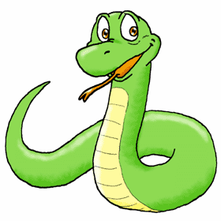

What is Python?

Slide 15

Why Python?
Monty Python's Flying Circus
An easy-to-learn programming language
The code is easy to read
Skills translatable to other languages

Slide 16






Who is using Python?

Slide 17
Q&A

Slide 18
Lecture Outline
Variables: assign a value to a Name and store variables to memory. Number and Character (case sensitive)
Math and operator: int vs double. Order of operations, power, remainder, increment and decrement, letter e in the middle of the number 3e5 = 3*10^5
Types of data: cast type. Try 0.1+0.2. Round down/up.
Input: raw_input(), int(), read()
Simple GUI: import library easygui to use dialogs, msgbox(), buttonbox(), choicebox(), enterbox(), set screen width and height
Decisions: if, elif, else, comparison operators, combine conditions, and / or / not
Loop: stop a runaway loop, range(), continue, break
Functions:

